Slide 1
Digital Portfolio
STUDENT NAME: P . SRITHARAN
REGISTER NO AND NMID: 24CDS06 ASBRU302428M0175
DEPARTMENT: BSC DATA SCIENCE
COLLEGE: COLLEGE/ UNIVERSITY Vidhyasagar College of Arts and Science, Udumalpet (Bharathiar University)

Slide 2
PROJECT TITLE
Futuristic Portfolio Website

Slide 3


AGENDA
Problem Statement
Project Overview
End Users
Tools and Technologies
Portfolio design and Layout
Features and Functionality
Results and Screenshots
Conclusion
Github Link
3/21/2024 Annual Review

Slide 4

PROBLEM STATEMENT
In today’s digital-first world, a static resume is not enough to showcase skills and achievements effectively. There is a need for a modern portfolio website that:
Highlights an individual’s skills, education, and projects.
Uses cinematic design, futuristic UI, and interactivity to stand out.
Provides recruiters and mentors with an accessible digital identity.

Slide 5

PROJECT OVERVIEW
This project is about building a personal portfolio website with HTML, CSS, and JavaScript.
It showcases:
About Me (Personal details, background)
Education (Timeline)
Projects (Showcase cards)
Contact (Email, Phone, GitHub link)
The design uses neon effects, animations, and futuristic transitions to give a professional + wow factor.

Slide 6

WHO ARE THE END USERS?
The end users are:
Recruiters → to quickly assess skills and projects.
Teachers/Mentors → to evaluate academic progress.
Peers & Tech Community → to showcase creativity and technical ability.
Personal Branding → acts as a digital resume.

Slide 7

TOOLS AND TECHNIQUES
HTML5: Structure of the portfolio.
CSS3: Styling, layout, animations, transitions.
JavaScript: Typing effects, scroll animations, particle background.
GitHub Pages: Hosting the live portfolio website.
VS Code: Code editor used to develop the project.

Slide 8
POTFOLIO DESIGN AND LAYOUT
Designed with a futuristic dark theme + neon glow accents.
Sections included: Home, About, Education, Projects, Contact.
Features a big profile image with glowing animation.
Background includes cinematic particle effects.
Responsive design → works on desktop & mobile.
8

Slide 9
FEATURES AND FUNCTIONALITY
Hero section: Animated typing text + glowing profile photo.
About section: Personal story + career goals.
Education section: Timeline cards with hover animations.
Projects section: Futuristic project cards with transitions.
Contact section: Form + clickable email/phone + GitHub link.
Animations: Smooth scroll, hover effects, cinematic particle background.

Slide 10
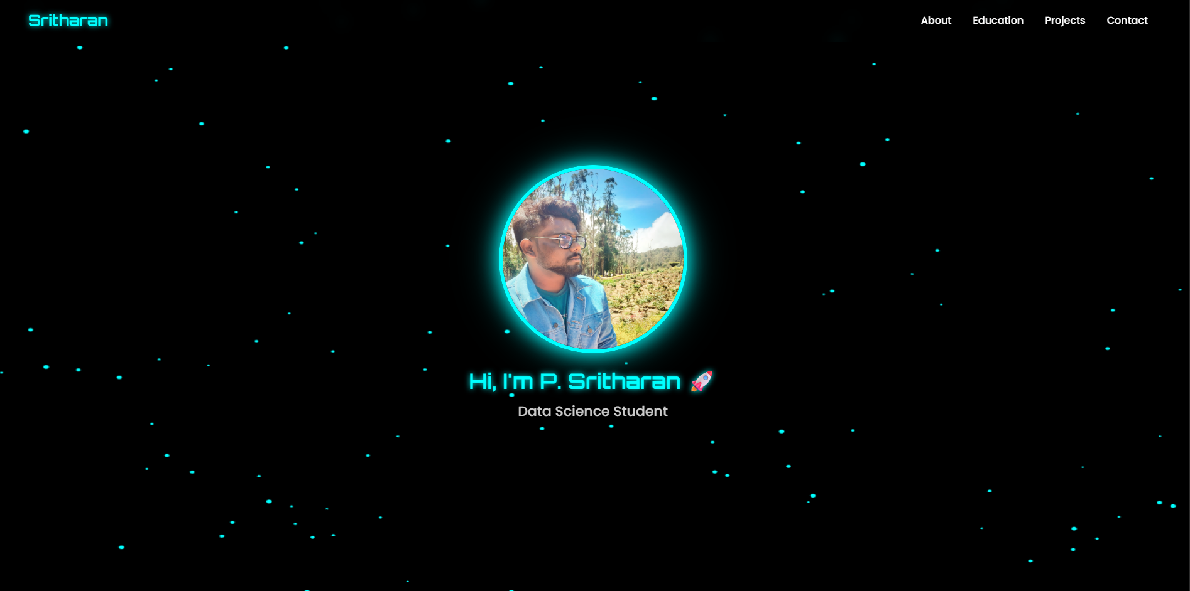

RESULTS AND SCREENSHOTS
3/21/2024 Annual Review
10

Slide 11
CONCLUSION
The portfolio website provides a futuristic, professional platform to showcase details, skills, and projects.
It acts as a digital resume, enhancing visibility, personal branding, and career opportunities.
The project helped in learning front-end development (HTML, CSS, JS) and hosting with GitHub Pages.
11

